Slide 1
PAN-EUROPE FOODS S.A.
CASE STUDY

Slide 2
Project Overview
Multinational company and headquartered in Brussels, founded at 1924.
Products
  ice cream (60% of the revenues),
  yogurt (20%),
  bottled water (10%),
  fruit juice (10%).
Marketing region (See Exhibit 1)

Slide 3
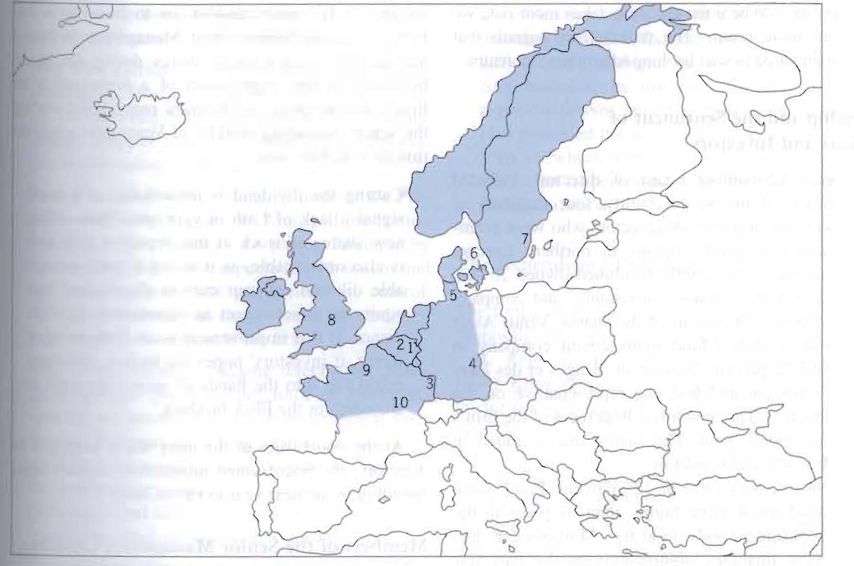
Exhibit 1

Slide 4
Capital Budget
11 major projects that totalled over EUR 208 million.
The board of directors had imposed a spending limit of EUR 80 million.
The challange for the senior managers was to allocate funds among a range of compelling projects; new product introduction, acquisition, market expansion, efficiency improvements, preventive maintenance, safety and pollution control.

Slide 5
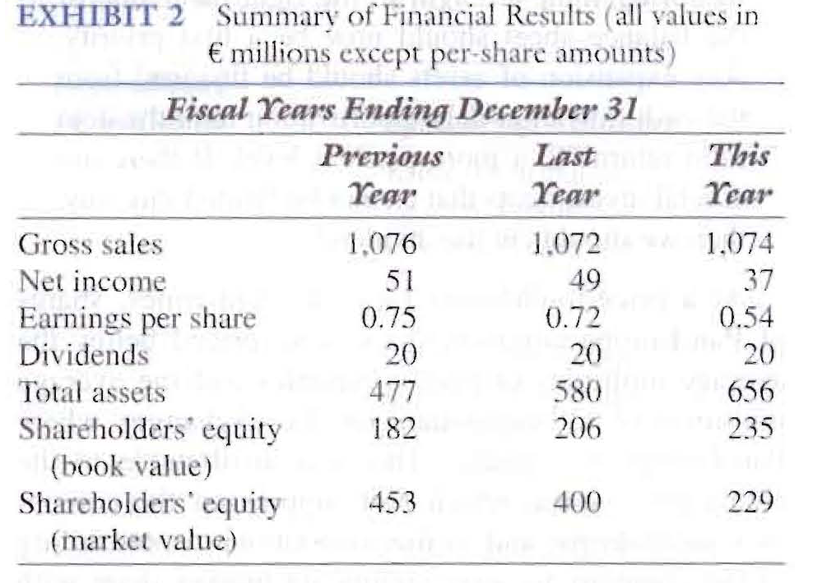
Pan-Europe Sales

Slide 6
Pan-Europe Sales (continued)
Sales had been static and reasons are;
  The low population growth in northern Europe
  Market saturation in some areas
  The recent failures in new product introductions
Some managers wanted to intruduce more new products.

Slide 7
Resource Allocation
The capital budget at Pan Europe was prepared annually and investment proposals included;
  Project description
  A financial analysis
  Strategic issues
  Qualitative considerations

Slide 8
Project evaluation
Two financial tests;
  Payback period
  IRR
Type Min. IRR Max. Payback
New product or new markets 12% 6 years
Product or market extension 10% 5 years
Efficiency improvements 8% 4 years
Safety or environmental No test No test
Weigted-average cost of capital (WACC): 10.5 %

Slide 9
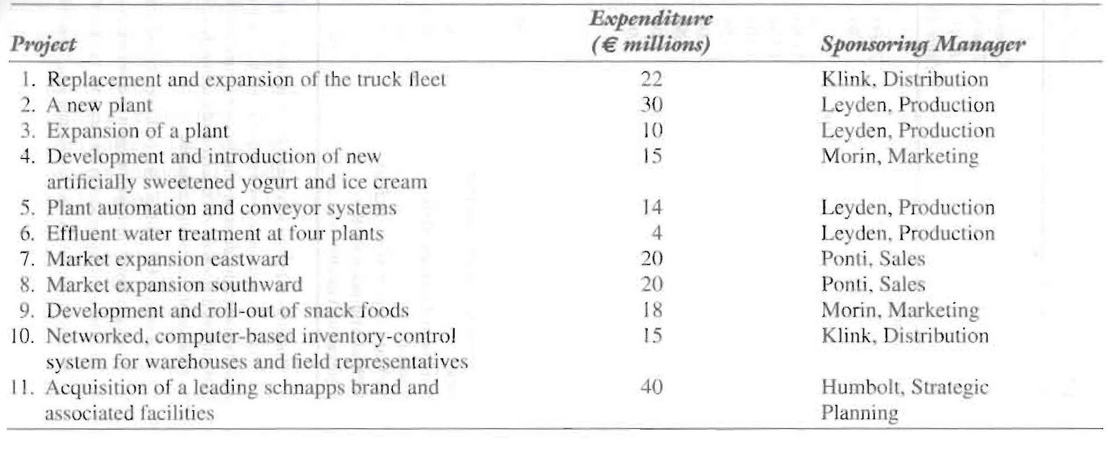
The Expenditure Proposals

Slide 10
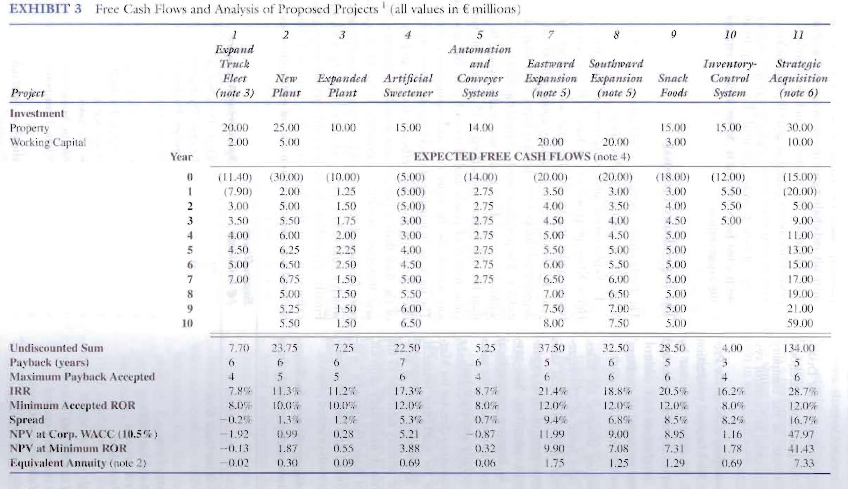

Slide 11
Question 1:
Pan-Europa is currently trading at a price below comparable companies. This is because of reduced profitability and a failure to gain sufficient market share for new products. As analysts are giving a “sell” signal, raiders are potentially buying up the stock. Clearly then they must pursue strategies that drive up their stock price. This includes increasing net income and gross sales.
Pan-Europa needs to capitalize on their hard earned increased market share.
Humbolt and Morin should be leading the charge on this strategy.

Slide 12
Question 2:
Exhibit 3 presents three different ways to look at the data. While the NPV at the minimum accepted ROR includes a risk premium, it doesn’t correct for the varying durations of the project. Instead the best available data would be the Equivalent Annuity that corrects for the project durations. Using this analysis the preferred project would be 11, the Strategic Acquisition. Then following in order would be:
Eastward Expansion
Snack Foods
Southward Expansion
Inventory Control System
Artificial Sweeteners
New Plant
Expanded Plant
Automation and Conveyor System
Expand Truck Fleet
Effluent Treatment Program (which has no NPV)
While the Effluent Treatment Program has no formal NPV, it can be considered an investment of $4 million now to save a cost of $10 million in 4 years.

Slide 13
Question 3:
There are many aspects that could invalidate the simple NPV analysis of the projects. They include:
Risk
Political considerations
Regulatory issues including health, safety, and environmental
Incompatibility with the corporate strategy
Resource availability
Impact on brand or corporate image
Quality and certainty of the data used for analyzing the various projects
Synergies between the projects
Different analysis techniques and different assumptions can be used to correct for the various factors that affect each project differently. For example:
The time value of money can be accounted for, by using discounting methods such as NPV or IRR.
Unequal lifetimes of the projects can be accounted for by calculating the NPV to infinity or using Equivalent Annuities.
Risk can be accounted for (at least financially) by increasing the hurdle rate.
The different project sizes can be accounted for by multiplying the NPV by the ratio of the size of the projects or by using a profitability ratio.

Slide 14
Question 4:
Project 6, the effluent water treatment plants is a “must do” project to meet regulatory requirements; it’s just a question of when. Project 5 is potentially one as well, depending on the regulatory environment that Pan-Europa’s safety record is measured in. Both safety and environment may be significant issues to the corporation’s image and stockholders, which would tend to elevate their importance.
Projects that involve small technology changes like expanding the truck fleet would have low risk. Increasing levels of technological sophistication, such as automation or introducing artificial sweeteners, into products would also increase implementation risks. Another risk area for any producer in a capitalist environment is attempting to increase markets with new products in new areas. The prospective customers may simply choose to not buy the product. Other elements of risk include project size, complexity, and length of the period of return.

Slide 15
There are real synergies between the plant expansion/additions, automation, truck upgrade, and geographic expansion projects.
Projects that have nonquantitative costs and benefits would include:
  Projects that impact the company’s regulator compliance such as effluent treatment (environment) and warehouse automation (safety).
  Several of the projects could impact the company’s image. For example, the snack food rollout could be positive because of its wholesome connotations, while the acquisition of the schnapps brand could be negative. The effluent project could be positive by showing the company’s willingness to act on environmental concerns early. Similarly, the automation project could cast a positive step towards increased safety. The plant expansion project may be positive or negative, depending on whether the community reacts to new jobs or factory encroachment.

Slide 16
Question 5:
I would recommend these five screens:
Is the project a “Must Do” for reasons outside of the company’s control?
  Criteria – Yes/No
Does the project meet the company policy for minimum IRR?
  Criteria –Yes/No
Does the project meet the company policy for maximum payback period?
  Criteria – Yes/No
Does the project incur excessive risk?
  Criteria – Yes/No
Does the project meet the current corporate strategy?
  Criteria – Yes/No

Slide 17
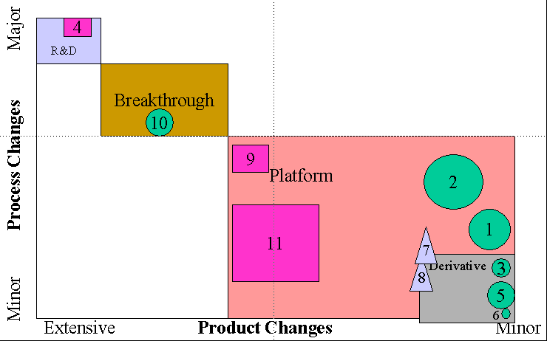
Question 6:
The projects would be arrayed as follows using the categories:

Slide 18
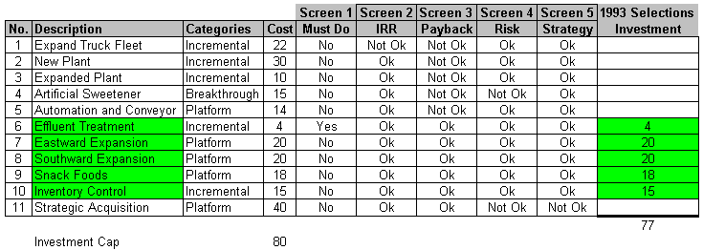
Question 7:
Applying the criteria to the projects would yield the following recommendations for the 1993 projects:
These projects would total 77 million ECU, leaving a prudent reserve for unforeseen circumstances.

